Slide 1
Chapter 4: Threads

Slide 2
Chapter Objectives
To introduce the notion of a thread - a fundamental unit of CPU utilization that forms the basis of multithreaded computer systems.
To discuss the APls for Phtreads, Win32, and Java thread libraries.

Slide 3
Content Overview
Overview
Multithreading Models
Threading Issues
Pthreads
Windows XP Threads
Linux Threads
Java Threads

Slide 4
4.1 Overview
A thread is a basic unit of CPU utilization.
It comprises a thread ID, a program counter, a register set, and a stack.
It shares with other threads belonging to the same process its code section, data section, and other operating-system resources, such as open files and signals.

Slide 5
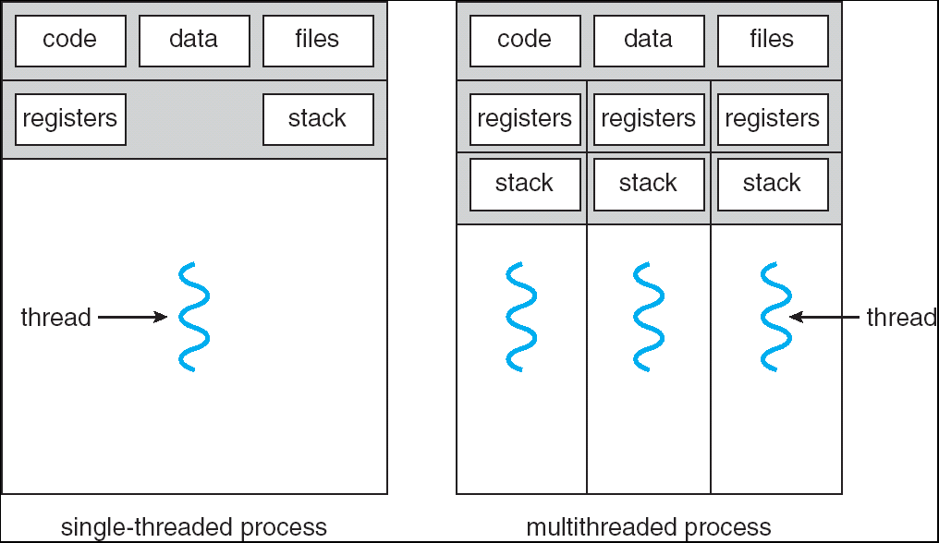
Single and Multithreaded Processes

Slide 6
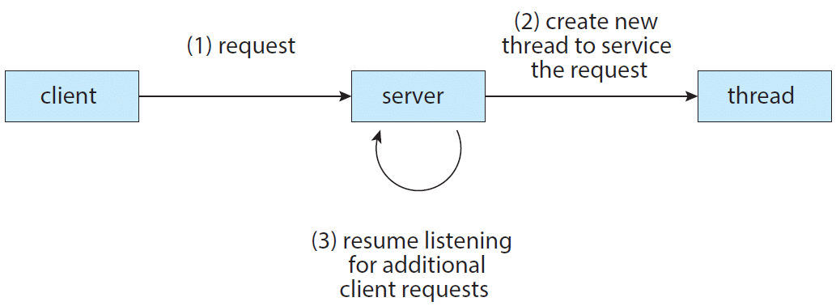
Multithreaded Server Architecture

Slide 7
Benefits
Responsiveness
Resource Sharing
Economy
Utilization of MP Architectures

Slide 8
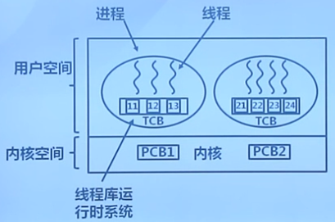
User Threads
User threads are supported above the kernel and are managed without kernel support(kernel know nothing about threads);
Switch is fast
Scheduling algorithms can be written by user
Blocking the whole process
Doesn’t support preemptive scheduling(抢占式调度)
Time slice is more short for thread
Thread management done by user-level threads library

Slide 9
用户级线程优缺点
优点：
线程切换快
调度算法是应用程序特定的
用户级线程可运行在任何操作系统上(只需要实现线程库)
缺点：
内核只将处理器分配给进程，同一进程中的两个线程不能同时运行于两个处理器上，同属一个进程的多个线程无法发挥多处理器的性能
大多数系统调用是阻塞的，因此，若内核阻塞进程，则进程中所有的线程也被阻塞
有时用户级线程也称为“协程”，Windows下的实现叫“纤程”

Slide 10
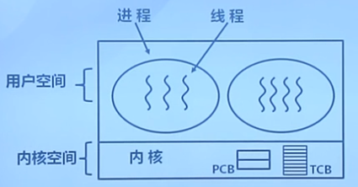
Kernel Threads
Kernel threads are supported and managed directly by the operating system. Supported by the kernel
Thread blocking doesn’t affect others
Management cost is more high

Slide 11
4.2 Multithreading Models
Ultimately, there must exist a relationship between user threads and kernel threads.
Many-to-One
One-to-One
Many-to-Many

Slide 12
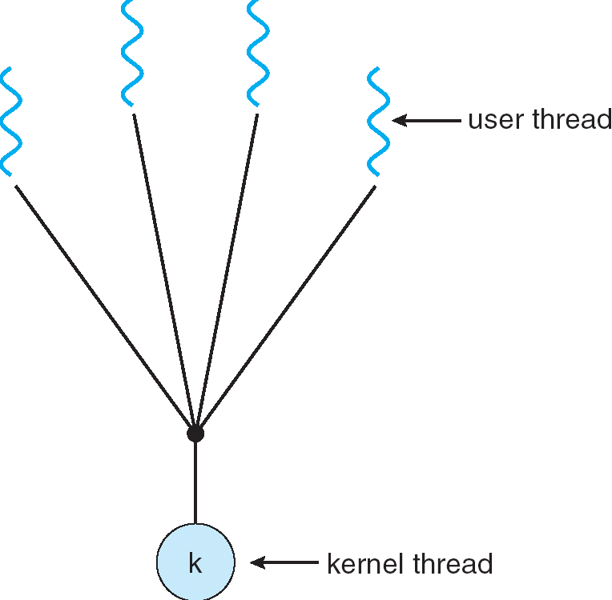
Many-to-One
Many user-level threads mapped to single kernel thread
Examples:
Solaris Green Threads
GNU Portable Threads
Thread management is done by the thread library in user space, so it is efficient;
But the entire process will block if a thread makes a blocking system call.
Because only one thread can access the kernel at a time, multiple threads are unable to run in parallel on multiprocessors.

Slide 13
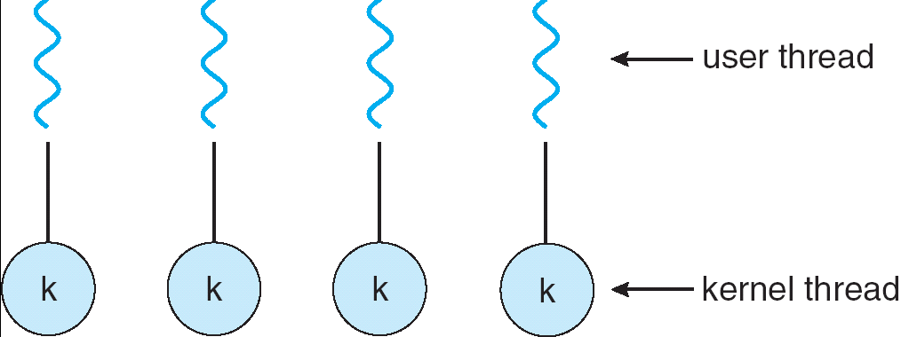
One-to-One
Each user-level thread maps to a kernel thread
It provides more concurrency than the many-to-one model by allowing another thread to run when a thread makes a blocking system call;
It also allows multiple threads to run in parallel on multiprocessors.
The only drawback is that creating a user thread requires creating the corresponding kernel thread, so restriction to the number of threads supported by the system is neccesary
Examples
Windows NT/XP/2000
Linux
Solaris 9 and later

Slide 14
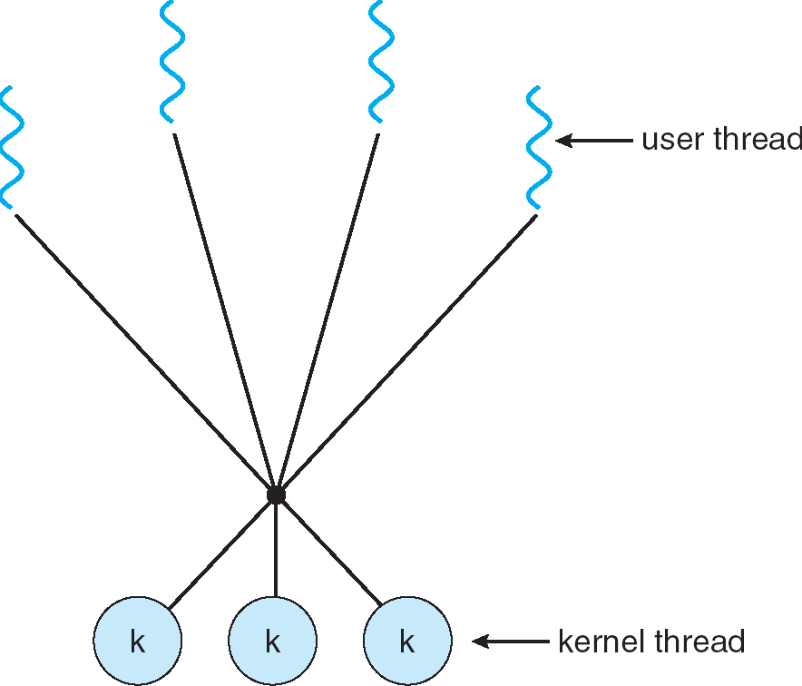
Many-to-Many Model
Allows many user level threads to be mapped to many kernel threads
Allows the operating system to create a sufficient number of kernel threads
Solaris prior to version 9
Windows NT/2000 with the ThreadFiber package

Slide 15
Two-level Model
Similar to M:M, except that it allows a user thread to be bound to kernel thread
Examples
SGI IRIX
HP-UX
DEC(HP) Tru64 UNIX
Sun Solaris 8 and earlier

Slide 16
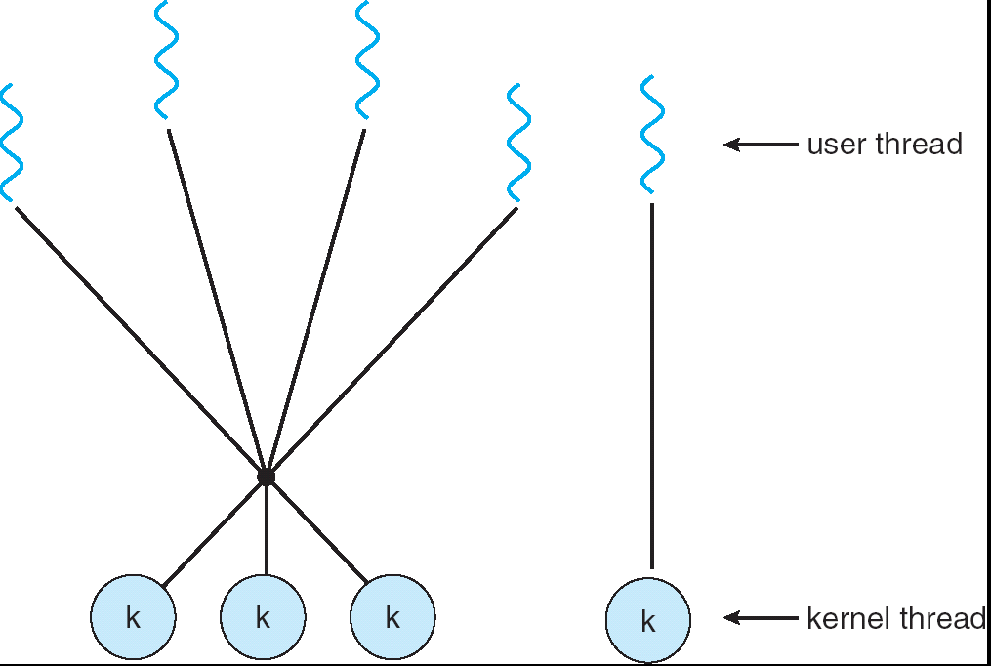
Two-level Model
M:M

Slide 17
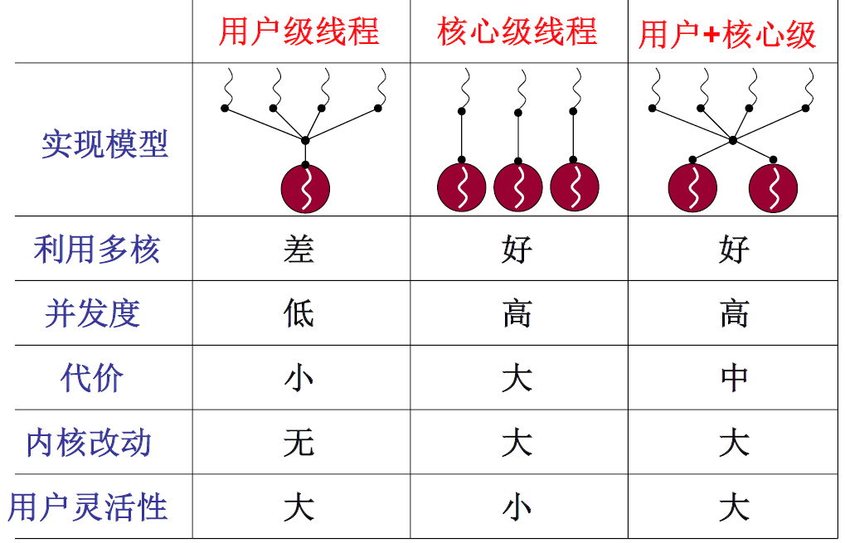
Comparison of User & Kernel Threads

Slide 18
4.3 Thread Libraries
Provides the programmer an API for creating and managing threads.
Two primary ways of implementing a thread library.
Provide a library entirely in user space with no kernel support. All code and data structures for the library exist in user space. This means that invoking a function in the library results in a local function call in user space and not a system call.
Implement a kernel-level library supported directly by the operating system. In this case, code and data structures for the library exist in kernel space. Invoking a function in the API for the library typically results in a system call to the kernel.
Three main thread libraries are in use
(1) POSIX Pthreads, (2) Win32, and (3) Java.

Slide 19
Pthreads
A POSIX standard (IEEE 1003.1c) API for thread creation and synchronization
API specifies behavior of the thread library, implementation is up to development of the library
Common in UNIX operating systems (Solaris, Linux, Mac OS X)

Slide 20
Pthreads Example 1/2
#include <pthread.h>
#include <stdio.h>
#include <stdlib.h>
int sum; /* this data is shared by the thread(s) */
void *runner(void *param); /* threads call this function */
int main(int argc, char *argv[])
{
pthread_t tid; /* the thread identifier */
pthread_attr_t attr; /* set of thread attributes */
/* set the default attributes of the thread */
pthread_attr_init(&attr);
/* create the thread */
pthread_create(&tid, &attr, runner, argv[1]);
/* wait for the thread to exit */
pthread_join(tid, NULL);
printf("sum = %d∖n", sum);
return 0;
} // gcc -o thrd-posix thrd-posix.c -lpthread

Slide 21
Pthreads Example 2/2
/* The thread will execute in this function */
void *runner(void *param)
{
int i, upper = atoi((char *)param);
sum = 0;
for (i = 1; i <= upper; i++)
sum += i;
pthread_exit(0);
}

Slide 22
Windows XP Threads
Implements the one-to-one mapping
Each thread contains
A thread id
Register set
Separate user and kernel stacks
Private data storage area
The register set, stacks, and private storage area are known as the context of the threads
The primary data structures of a thread include:
ETHREAD (executive thread block)
KTHREAD (kernel thread block)
TEB (thread environment block)

Slide 23
Windows Multithreaded C Program 1/2
#include <windows.h>
#include <stdio.h>
DWORD Sum; /* data is shared by the thread(s) */
/* The thread will execute in this function */
DWORD WINAPI Summation(LPVOID Param)
{
DWORD Upper = *(DWORD*)Param;
for (DWORD i = 1; i <= Upper; i++)
Sum += i;
return 0;
}

Slide 24
Windows Multithreaded C Program 2/2
int main(int argc, char *argv[]) {
DWORD ThreadId;
HANDLE ThreadHandle;
int Param;
Param = atoi(argv[1]);
/* create the thread */
ThreadHandle = CreateThread(
NULL, /* default security attributes */
0, /* default stack size */
Summation, /* thread function */
&Param, /* parameter to thread function */
0, /* default creation flags */
&ThreadId); /* returns the thread identifier */
/* now wait for the thread to finish */
WaitForSingleObject(ThreadHandle, INFINITE);
/* close the thread handle */
CloseHandle(ThreadHandle);
printf("sum = %d∖n",Sum);
return 0; }

Slide 25
Java Threads
Java threads are managed by the JVM
Java threads may be created by:
Extending Thread class
Implementing the Runnable interface

Slide 26
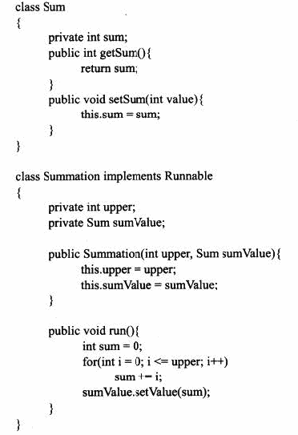
Java Threads 1/2

Slide 27
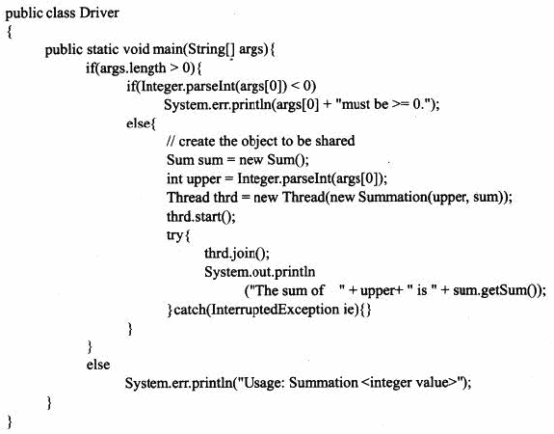
Java Threads 2/2

Slide 28
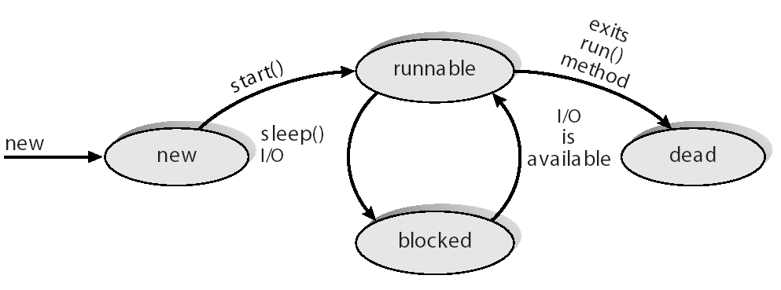
Java Thread States

Slide 29
4.4 Threading Issues
Semantics of fork() and exec() system calls
Thread cancellation
Signal handling
Thread pools(线程池)
Thread specific data
Scheduler activations

Slide 30
Semantics of fork() and exec()
Does fork() duplicate only the calling thread or all threads?
Some UNIXes have two versions of fork()
exec() usually works as normal – replace the running process including all threads

Slide 31
Thread Cancellation
Terminating a thread before it has finished
Two general approaches:
Asynchronous cancellation(异步撤销) terminates the target thread immediately
Deferred cancellation(延迟撤销) allows the target thread to periodically check if it should be cancelled

Slide 32
Signal Handling
Signals are used in UNIX systems to notify a process that a particular event has occurred
A signal handler is used to process signals
Signal is generated by particular event
Signal is delivered to a process
Signal is handled
Options:
Deliver the signal to the thread to which the signal applies
Deliver the signal to every thread in the process
Deliver the signal to certain threads in the process
Assign a specific thread to receive all signals for the process

Slide 33
Thread Pools(线程池)
Create a number of threads in a pool where they await work
Advantages:
Usually slightly faster to service a request with an existing thread than create a new thread
Allows the number of threads in the application(s) to be bound to the size of the pool

Slide 34
Thread Specific Data
Allows each thread to have its own copy of data
Useful when you do not have control over the thread creation process (i.e., when using a thread pool)

Slide 35
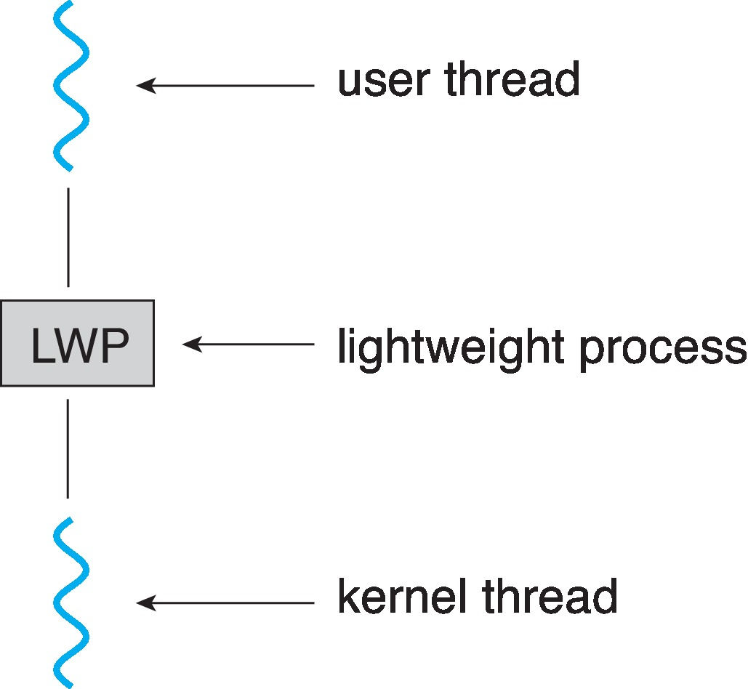
Scheduler Activations(调度程序激活)
Both M:M and Two-level models require communication to maintain the appropriate number of kernel threads allocated to the application
Typically use an intermediate data structure between user and kernel threads – lightweight process (LWP)
Appears to be a virtual processor on which process can schedule user thread to run
Each LWP attached to kernel thread
How many LWPs to create?
Scheduler activations provide upcalls - a communication mechanism from the kernel to the upcall handler in the thread library
This communication allows an application to maintain the correct number kernel threads

Slide 36
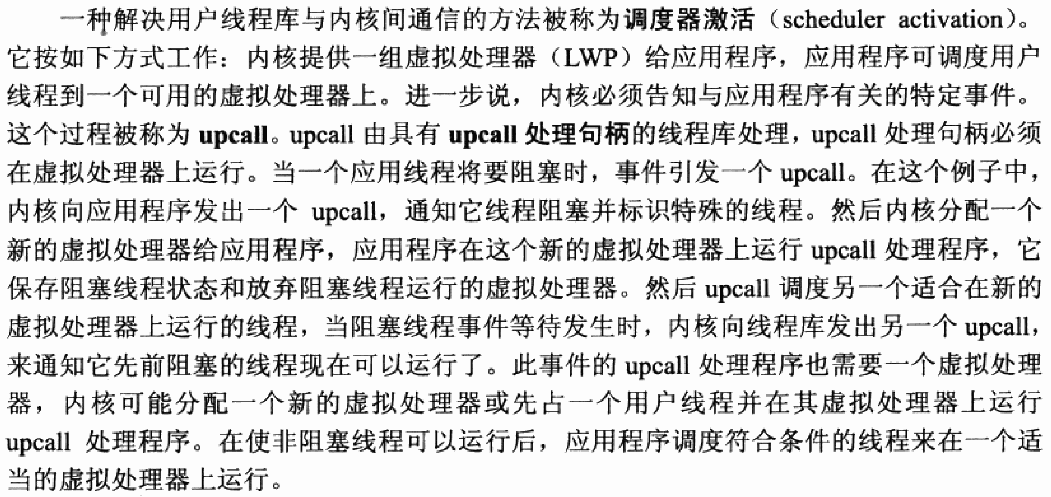
调度程序激活

Slide 37
Summary 1/3
A thread represents a basic unit of CPU utilization, and threads belonging to the same process share many of the process resources, including code and data.
There are four primary benefits to multithreaded applications: (1) responsiveness, (2) resource sharing, (3) economy, and (4) scalability.
Concurrency exists when multiple threads are making progress, whereas parallelism exists when multiple threads are making progress simultaneously. On a system with a single CPU, only concurrency is possible; parallelism requires a multicore system that provides multiple CPUs.

Slide 38
Summary 2/3
User applications create user-level threads, which must ultimately be mapped to kernel threads to execute on a CPU. The many-to-one model maps many user-level threads to one kernel thread. Other approaches include the one-to-one and many-to-many models.
A thread library provides an API for creating and managing threads. Three common thread libraries include Windows, Pthreads, and Java threading. Windows is for the Windows system only, while Pthreads is available for POSIX-compatible systems such as UNIX, Linux, and macOS. Java threads will run on any system that supports a Java virtual machine.

Slide 39
Summary 3/3
Threads may be terminated using either asynchronous or deferred cancellation. Asynchronous cancellation stops a thread immediately, even if it is in the middle of performing an update. Deferred cancellation informs a thread that it should terminate but allows the thread to terminate in an orderly fashion. In most circumstances, deferred cancellation is preferred to asynchronous termination.
Unlike many other operating systems, Linux does not distinguish between processes and threads; instead, it refers to each as a task. The Linux clone() system call can be used to create tasks that behave either more like processes or more like threads.

Slide 40
End of Chapter 4: Threads

